Slide 1

The Role of Exercise in Bariatric and Metabolic Surgical Patient

Slide 2

Introduction

Slide 3

≥50% EWL ≥10 years
BUCHWALD et al., 2014

Slide 4
12 years | 6 years | 2 years
− 35 kg | − 36.3 kg | − 45 kg
DM2 ⬇ 51% | DM2 ⬇ 62% | DM2 ⬇ 75%
ADAMS et al., 2017

Slide 5

 | 1 year | 3 years
Body pain | 57.6% | 48.6%
Physical Function | 76.5% | 70.2%
KING et al., 2016

Slide 6
⬇ LEAN MASS LOSS
⬇ REE
⬇ Body Function
⬇ Weight Loss
⬇ Physical Activity
Obesity
+
Related Comorbidities
COLE et al., 2017
MOEHLECKE et al., 2017
CARNERO et al., 2017

Slide 7
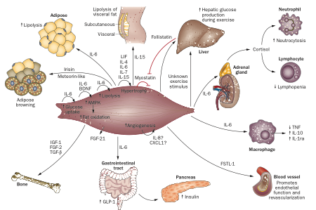
BENATTI et al., 2014

Slide 8
PEDERSEN et al., 2012

Slide 9
PEDERSEN et al., 2012

Slide 10
Common Barriers to Exercise in the Patient with Morbid Obesity

Slide 12

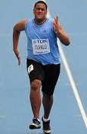
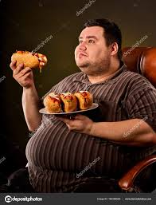
WOULTERS et al., 2011

Slide 13
General Population
Time
Energy
Motivation
Canadian Fitness and Lifestyle Research Institute, 1996
McAuley et al, 1990

Slide 14
Bariatric Patients
28 % Time
78,1% Motivation
20,5% Physical limitations
23 % No PA services or unhelpful
PEACOCK et al., 2014

Slide 15
Overcoming Barriers to Exercise

Slide 16

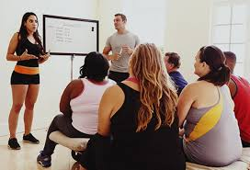

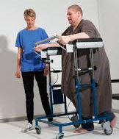
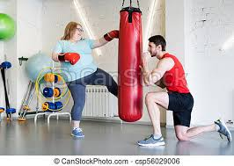
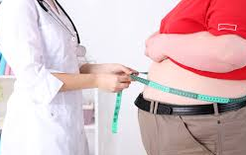
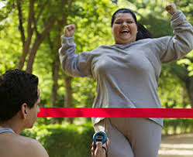



Slide 17
LACK OF TIME = LACK OF ORGANIZATION
"You will never ‘find' time for anything. If you want time,
you must make it!!!"
1. Take note of your daily tasks, during the week. You can observe in detail where you’re investing your time.
Activity | Start time | End time | Observation
Wake up and shower | 7:00 | 7:30
Dress | 7:30 | 7:45
Work | 8:00 | 12:00 | 20min coffee/social media
Lunch/rest | 12:00 | 14:00
Work | 14:00 | 18:00
Supermarket | 18:30 | 19:00
Preparing Dinner | 19:00 | 20:00 | …
WHITMORE J, 2011

Slide 18
2. Choose the activity and the best time for you, then include it in your schedule.
Activity | Start time | End time | Observation
Wake up, dress, eat a fruit | 6:00 | 6:15
Take a brisk walk | 6:15 | 6:45
Flexibility exercise | 6:45 | 7:00
Shower | 7:00 | 7:30
Dress | 7:30 | 7:45
Work | 8:00 | 12:00
WHITMORE J, 2011

Slide 19
Activity | Start time | End time | Observation
Wake up and shower | 7:00 | 7:30
Dress | 7:30 | 7:45
Work | 8:00 | 12:00 | 20min cofee/social media
Gym | 12:00 | 13:00
Lunch | 13:00 | 14:00
Work | 14:00 | 18:00
Preparing Dinner | 19:00 | 20:00 | …
Activity | Start time | End time | Observation
Wake up and shower | 7:00 | 7:30
Dress | 7:30 | 7:45
Work | 8:00 | 12:00 | *Stand up every 2h
Lunch/rest | 12:00 | 14:00
Work | 14:00 | 18:00
Gym | 18:15 | 19:15
Preparing Dinner | 19:30 | 20:30 | …

Slide 20
3. Design an Action Plan, with specific steps! Follow the model:
ACTION PLAN
TASK:
 | What? | Where? | When? | Why? | Who? | How? | How Much?
Step 1
Step 2
Step 3
Step 4
EVIDENCE:
WHITMORE J, 2011

Slide 21
ACTION PLAN
TASK : Start a Physical Training at a Gym
 | What? | Where? | When? | Why? | Who? | How? | How Much?
Step 1 | Look for a good gym | Near my work | Nov 25th 3:00pm | Quit physical inactivity to improve my QoL | Just me | Search on the internet | ---
Step 2 | Buy fitness clothes | Fitness Store | Nov 26th Lunch time | To feel confortable exercising | My friend Lara | I’ll pick up Lara, to be sure I'm not going to skip (shame) | $200
Step 3 | Organize a bag | My home | Nov 26th After work | Save time, avoid skipping classes | Just me | Clothes, sneakers, towel, etc | ---
Step 4 | First Class | Gym | Nov 27th, 18:15pm | Help weight loss, gain muscle | Gym coach | Remember how important is | $100 per month
EVIDENCE: Message to my coach when I finished the steps

Slide 22
LACK OF MOTIVATION
Try to discover where does it come from
Don't like some specific types of activity
Bad experiences with exercises (body pain, shame, failured to reach their goals)
Don’t believe in exercises benefits
Fear of Injuries
2. Based on the first step, what can we do to help?
Support groups
Professionals of mental health are fundamental here!
*Adequate exercise programs
WHITMORE J, 2011

Slide 23
LACK OF ENERGY
Could be related to:
Diet
Sleep
Stress
Low physical fitness
Other health condition
PHYSICAL LIMITATIONS
Physician assessment – best treatment available
Physiotherapist
Exercise physiologist / coach
WHITMORE J, 2011

Slide 24
How important is exercise program for you? Why?
Imagine that you’ve been training for more than a year, with no interruptions. How does it feel?
Describe the perfect you in 2 years. What are the new habits?
WHITMORE J, 2011

Slide 25
Optimizing Physical Fitness in the
Pre-Operatory Patient

Slide 26
Time waiting for surgery:
No physical activity program
Weight Gain
Increase Comorbidities
Raise Mortality Rate
BORISENKO et al., 2015
PEAKOCK et al., 2014
FONSECA et al., 2013

Slide 27
1.57% deaths
21.6 months awaiting surgery
LAKOFF et al., 2015
8.77% deaths
24 months awaiting surgery
MARCON et al., 2016

Slide 28
Cardiorespiratory Fitness
Short-term Complications
McCullough et al., 2006

Slide 29
⬇ LEAN MASS LOSS
⬇ REE
⬇ Body Function
⬇ Weight Loss
⬇ Physical Activity
+ Obesity
+Related Comorbidities
COLE et al., 2017
MOEHLECKE et al., 2017
CARNERO et al., 2017

Slide 30
Time waiting for surgery:
Engaged in Physical activity program
Lipid profile
Fasting glucose
Blood pressure
Functional capacity
Weight loss
Better quality of life
Pain reduction
MARCON et al., 2016

Slide 31
Benefits of Exercise in
Weight Loss and Maintenance

Slide 32
Physical Training
Decreased body fat
Increased body glucose utilization
Reduced resting blood pressure
Improved lipid profile
Enhanced vascular condition
Increased gastrointestinal transit speed
Improved functional capacity
Improved bone mineral density
WESTCOTT et al., 2009

Slide 33
Physical Training
Reduced pain
Decreased depression levels
Reduced metabolic syndrome risk
Reduced premature all-cause mortality
Reduced cardiovascular disease
WESTCOTT et al., 2009

Slide 34
Guidelines to Exercise Prescription

Slide 35
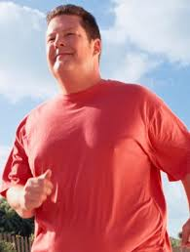
American College of Sports Medicine - ACSM
Cardiorespiratory (Aerobic) Exercises
Strength (Resistance) Training
Neuromotor Exercise
Flexibility Program

Slide 36
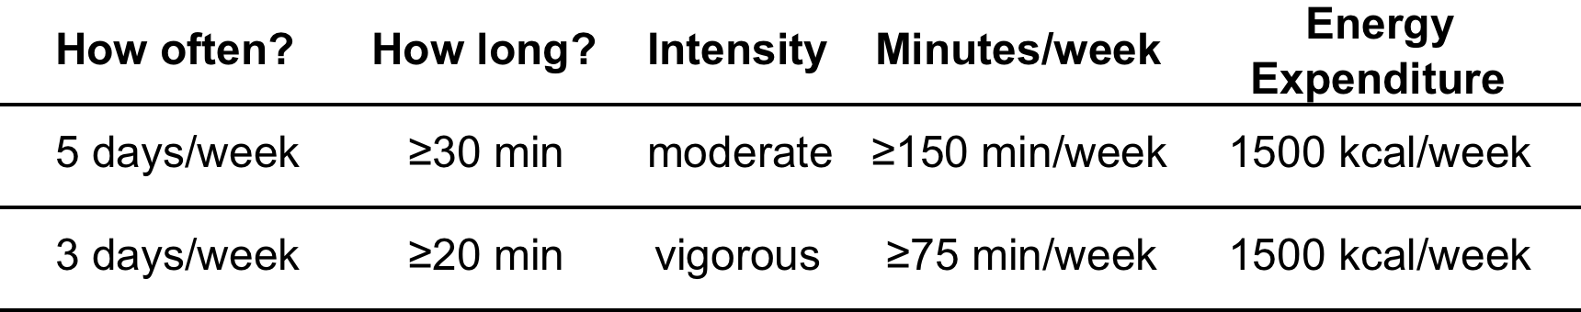

CARDIO
GARBER et al., 2011
SHOELLER, 1997
WING et al., 2001
JAKICIC et al., 2003

Slide 37
CARDIO
50%
≥ 2000 kcal/week
80%
≥1500 kcal/week
SHAH et al., 2011

Slide 38
CARDIO
CASTELLO et al., 2011

Slide 39
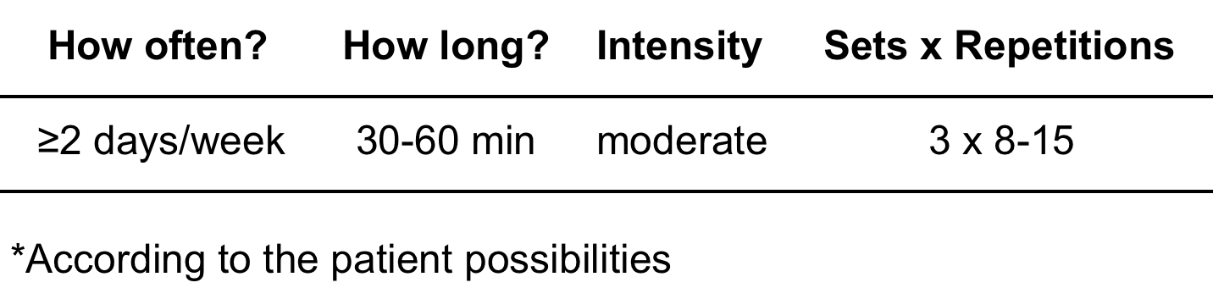
Strength Training
GARBER et al., 2011

Slide 40
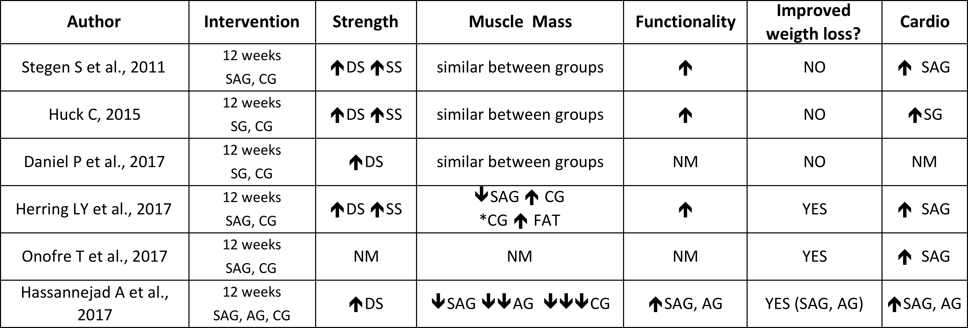
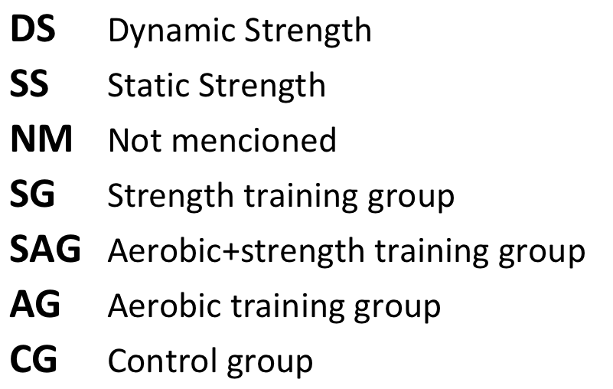
Strength Training

Slide 41
Strength Training
36 weeks
30% TRAINING GROUP didn’t lost muscle mass
CONTROL GROUP lost 50% more muscle mass
VERSIANI et al., 2017

Slide 42
178%
121%
VERSIANI et al., 2017

Slide 43
Neuromotor Exercises
Sudden changes in body center of gravity
2 - 3 times a week
Balance
Agility
Coordination
Gait improvement
Motor skills
Flexibility Program
Lean mass loss + 30 days (or more) post surgery resting
Joint range of movement
Body functionality
At least 2 times per week. Every day is better!
WESTCOTT et al., 2009
GARBER et al., 2011
VARTIAINEN et al., 2012

Slide 44
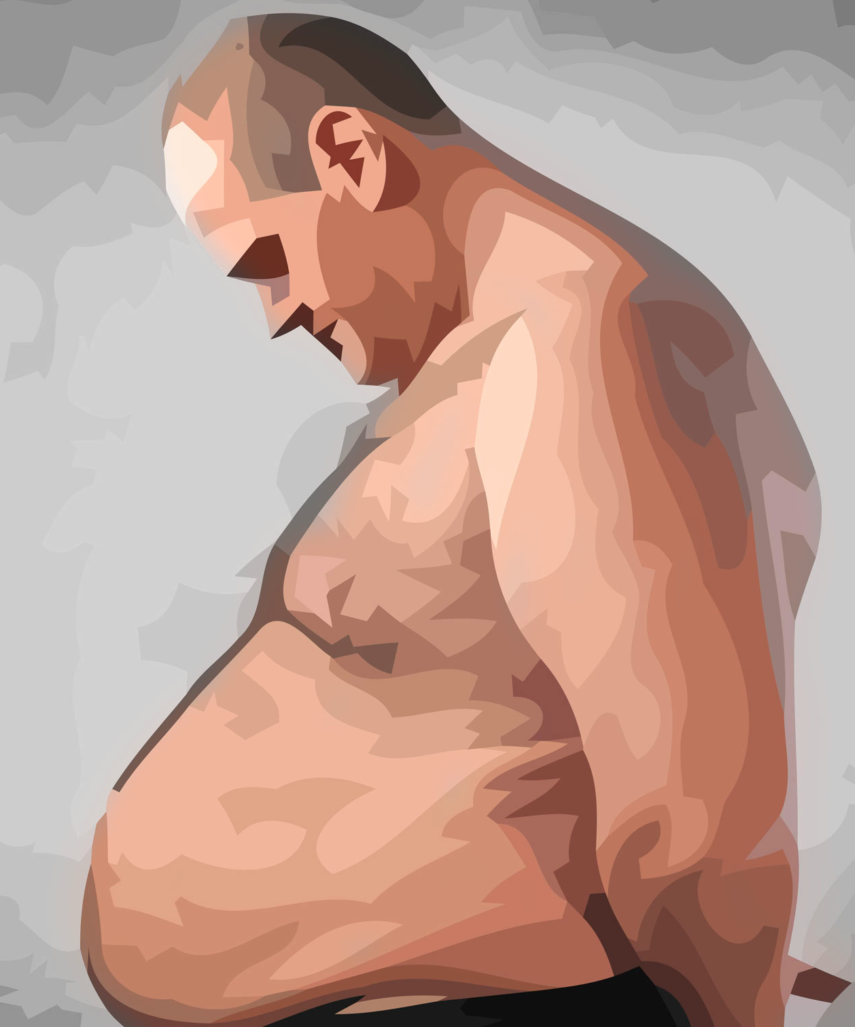
How do we start?
↓±10/15kg
↓ Lean mass
↓Cardiorespiratory fitness
Weakness, vertigo…
500 – 700 kcal/day

Slide 45
What do they need?
Postural reorganization
Cardiorespiratory fitness
Body functionality
↓ Fat mass ↑Lean mass

Slide 46
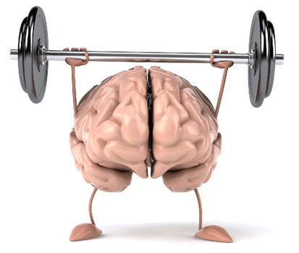
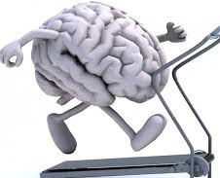
1. Neuromuscular Adaptation
Strength Training:
Movement control
Variety of exercises and equipment
Avoid complex exercises
Simple sets
Pilates, functional training
TRAINING ADHERENCE!!!
Cardio:
Low impact
Walking, sometimes barefoot (proprioception)
Improve gait
IMPACT: 5km/h = 1,5 body weight!
HASS et al., 2000
VARTIAINEN et al., 2012
Notes:
Vivência motora
Sedentários: series simples e multiplas nao mostraram diferença significante

Slide 47
2. Muscular Hypertrophy
Strength Training:
Rest Metabolic Rate (1kg LM = 15 kcal/kg/day)
⬆ Mechanical shock absorption
⬆ Posture, skeleton support
Immunity
Physiological and metabolic parameters
Mental health …

Slide 48
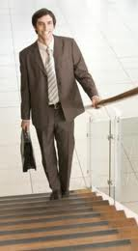
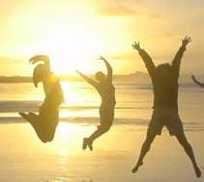
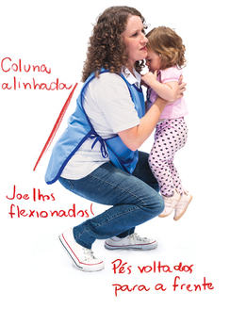
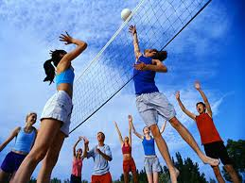


3. Power Training
Very Related with Daily Life!
Sitting and standing up
Climbing stairs
Push and Pull
Trunk rotations
Lift weights
Notes:
Trabalho multiarticular, diferentes eixos de movimento

Slide 49
3. Power Training
Strength Training:
↑ Velocity
↑ Caloric expenditure
↑ Lean Mass and Strength
Aerobic Training:
↑Impact = ↑Bone and cartilage density SAAMENEM, 1989; JURVELIN, 1990; HELMINEN 1992
Interval or Circuit Training
Notes:
Levantar da cadeira é Potencia, apanhar algo que cai, mudanças de direçao, reaçao a um tropeço
Seu cliente pode ir praticar o esporte ou atividade que ele eleger
Lesões* ex levantamento olimpico quase nao tem lesão pq evolui devagar
Carga + execução com tecnica correta. Evitar fadiga

Slide 50
4. Raise Caloric Expenditure
CALORIC EXPENDITURE
HIIT
CROSS TRAINING
CIRCUIT TRAINING
SPORTS
RUNNING
GOAL
≥2.000 kcal/week
ACSM, 2011

Slide 51
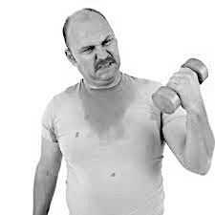
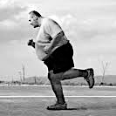
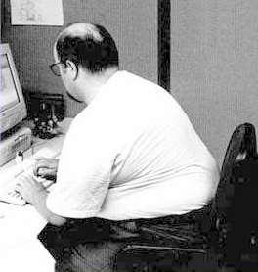
Is that all?

Slide 52
Active Lifestyle x Mortality
40% women
< 3 hours
94% women
20% men
48% men
INACTIVITY
≥ 6 hours
PATEL et al., 2010

Slide 53
Takeaway Points

Slide 54
The effects of bariatric surgery will not last forever, so...
Multidisciplinary team is indispensable!
Discuss deeply the benefits of an exercise program with your patients, as well as the harmful effects of physical inactivity
Meet your team often to discuss patients cases and design strategies together
Create support groups where people can share their difficulties
The staff must be trained on the main barriers to exercise
The first step is prescribe exercise focusing on keeping the patient training. The second one is reach physiologic goals!
Remember: the best way to teach is through examples – so let’s move!!!

Slide 55

Thank you very much!
Obrigada!
Gracias!
cris.aquino@me.com
+55 (41) 99206 5109

Slide 56
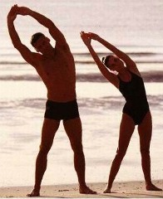
Physical Activity
Planned
Exercises
No commitment
Defined goals
Random
Daily Activities
Structured
ACSM Guidelines, 2011

